Slide 1
Dog Shelter Online {presentation}

Slide 2
App Concept
A place for dog lovers to find homeless dogs in your neighborhood shelters and have a chance to regularly check on, and provide for them.

Slide 3
Website Story
Dog Shelter Online is a website which allows users to find homeless dogs in different shelters. Once users are registered and log in, they would be able to access our database with over hundreds of dogs online.
What’s More is that our service provides an opportunity which allows users to use our data information to physically locate the dogs. Later they can continue to interact with the dogs and other users by visiting our website, post/comment on their most up to date conditions, as well as exchanging information and having discussions.
More info on Dog Shelter Online, please visit at https://github.com/JYL-LU/Group-Project-2-online-pet-home
Created by: Jane Lu, Chao Deng

Slide 4
How do we build it
Determine the design process

Slide 5
Design Process
Using Handlebars and Material Design for Bootstraps to create a frontend design
2
1
3
Creating a backend for data and api routes that links between front and backend using node and express. Js as well as sequelize and mysql2
Using Heroku to deploy our application

Slide 6
This is a list of tools we have used
Node.js and Express.js
Sequelize
Mysql2
Handlebars.js
Heroku
Bcrypt
Connect-session-sequelize
Dotenv
Material Design for Bootstrap

Slide 7
User Information
Register
Once users visit our website, they will need to create a username and a password for their user account.
Log in and Log out
Our website will store all user information safely using bcrypt.

Slide 8
App Interaction
Login
Users will need to log in their own account to access our database.
Review our dog info
Review all and look for a specific dog by using their id, and names.
Comment
Updating dog’s condition by posting comments and share ideas/having discussions with other users online.

Slide 9
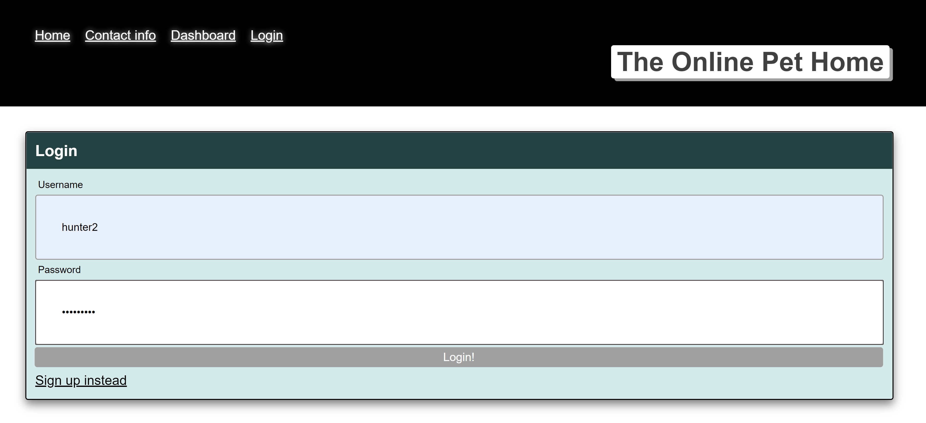
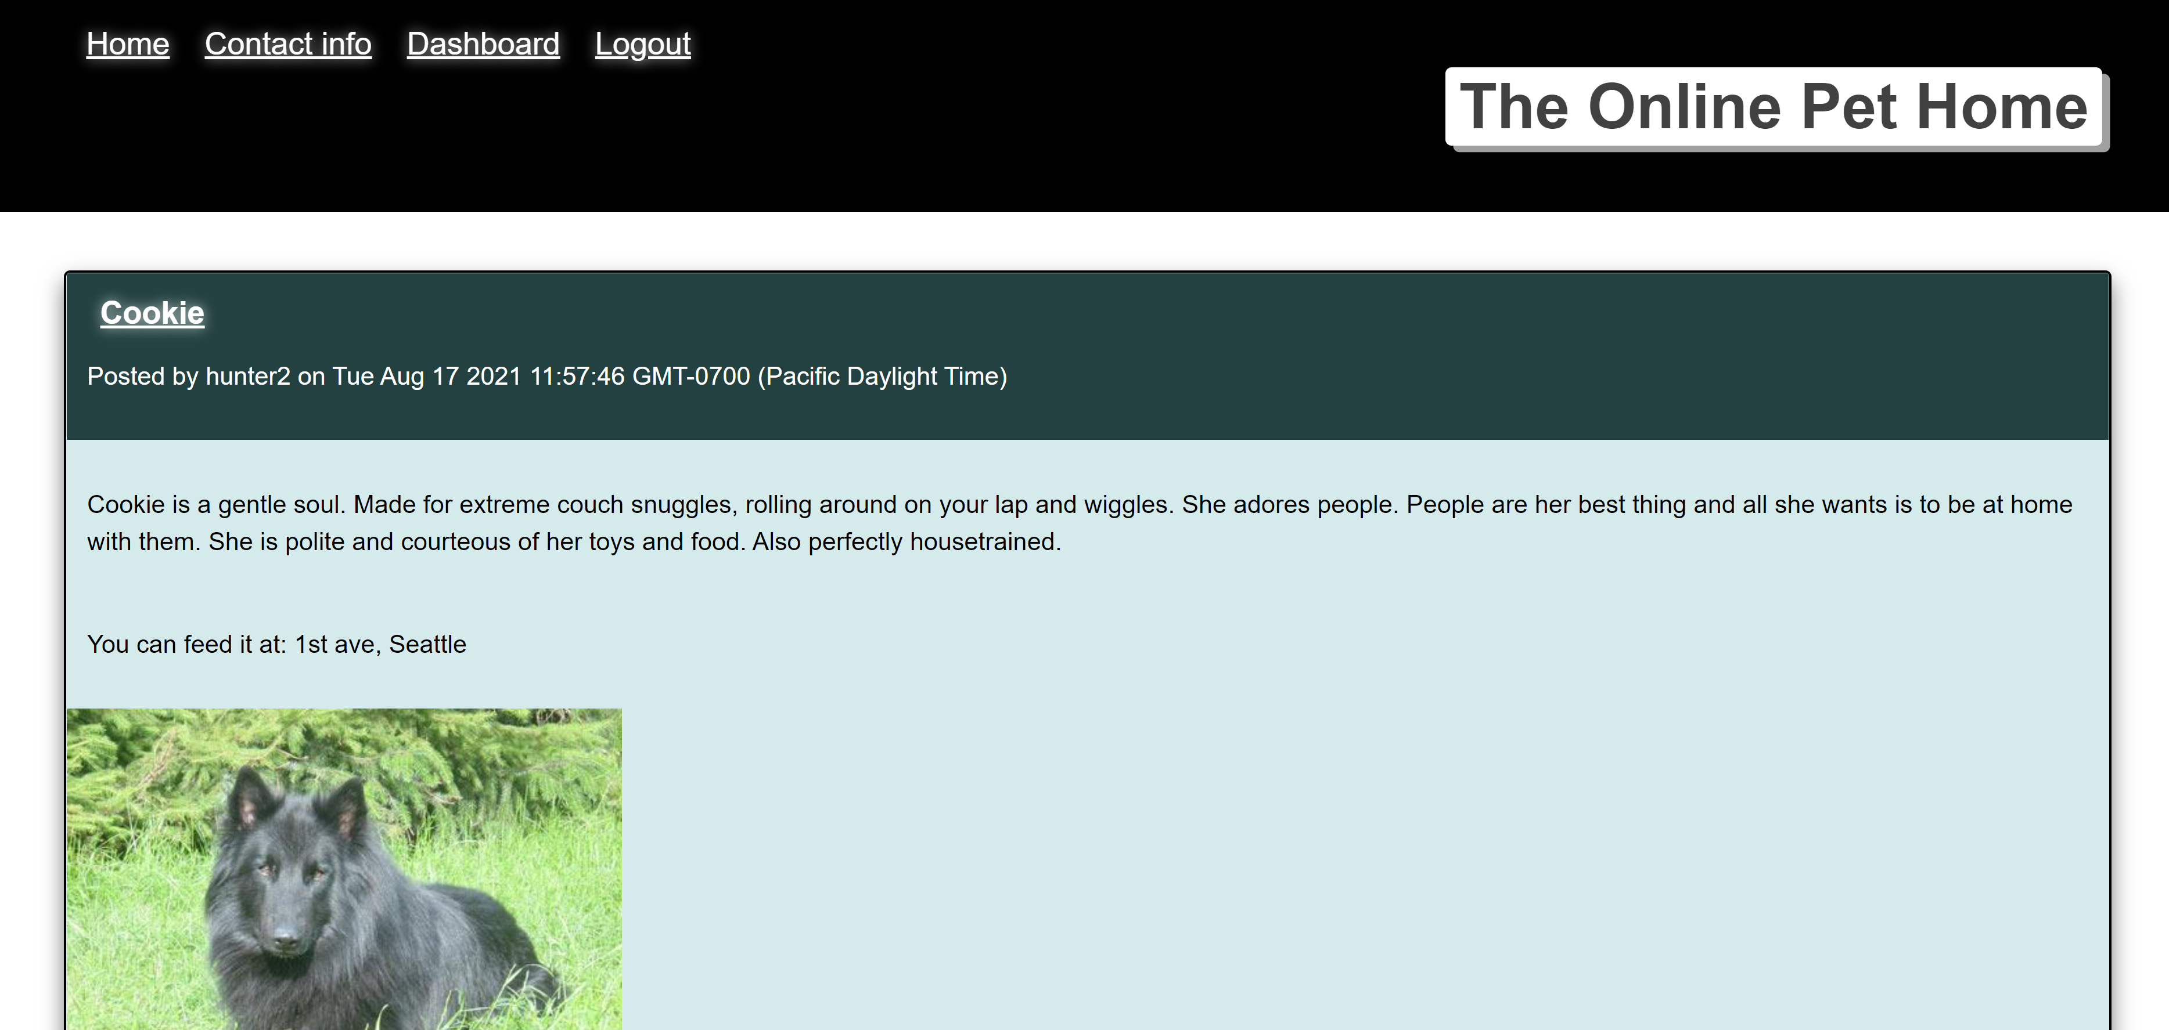
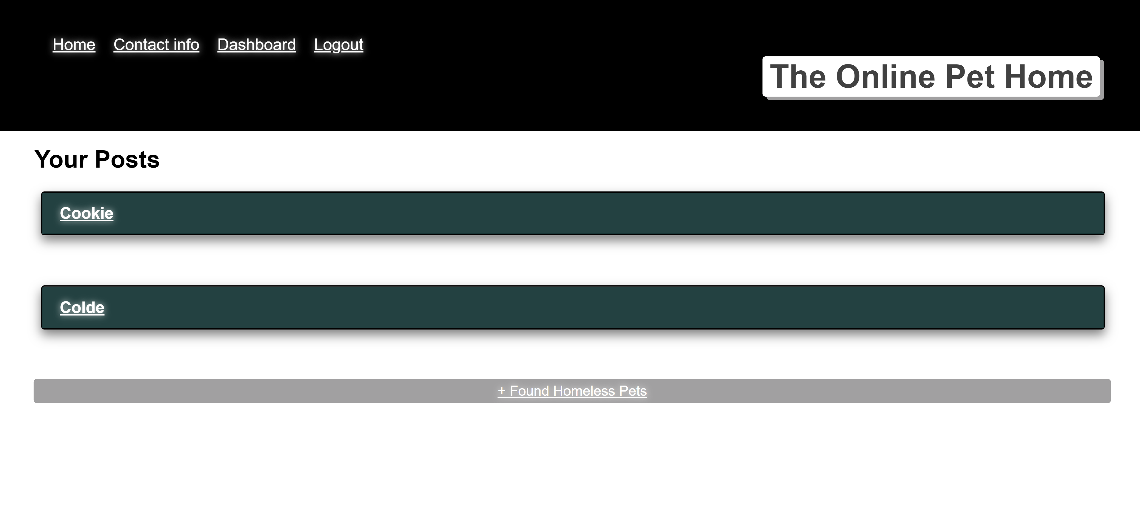
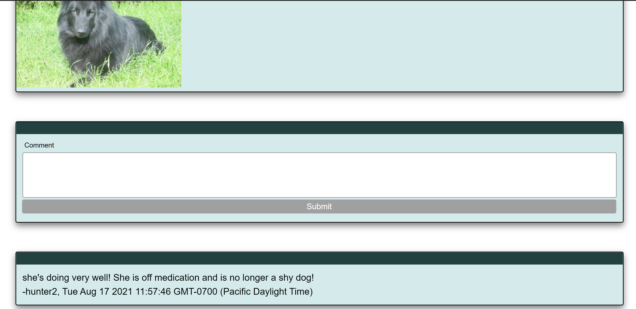
App Demonstration
User page
Home page
Dashboard page
Comment page

Slide 10
Later Improvement
Our Mobile App
Template
We would like to optimize our app by creating a mobile version so our users can access our app more efficiently.

Slide 11
Later Improvement
We would like to link google map with different shelter locations so that our users can have a better idea of where the dog’s actual location is.

Slide 12
Thanks!
Any questions ?
You can find us at
https://github.com/JYL-LU/Group-Project-2-online-pet-hom
Jyl.janelu@gmail.com
hunterd3c@gmail.com

